Slide 2
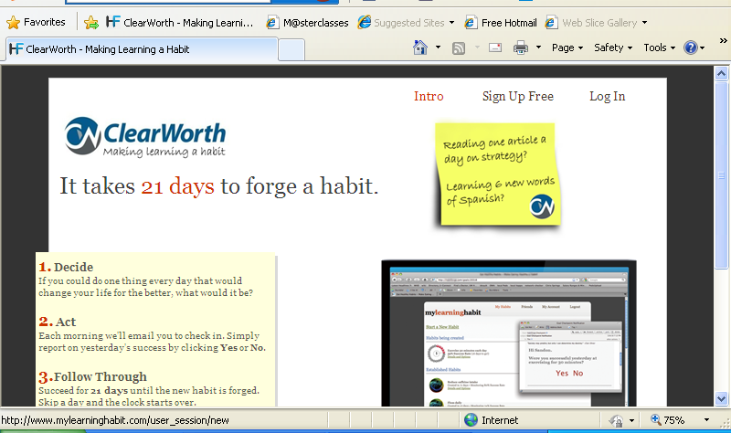
Notes:
Info box needs aligning, move to right so lines up.

Slide 3
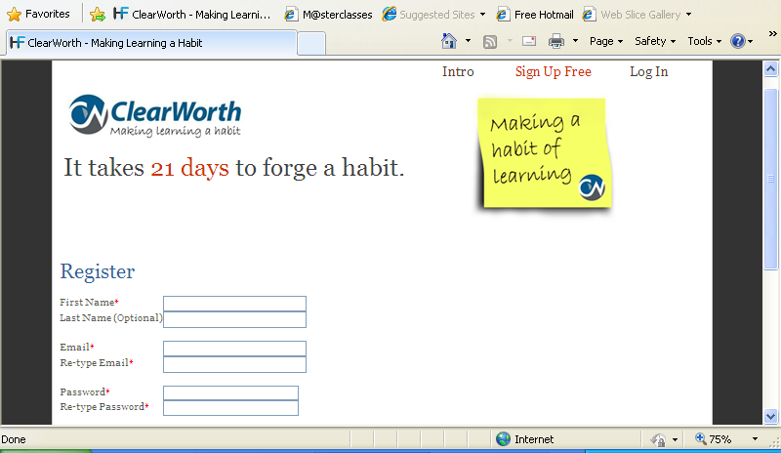
Notes:
Change to ‘making learning a habit’ in post-it, increase and move bottom right (by time zone)

Slide 4
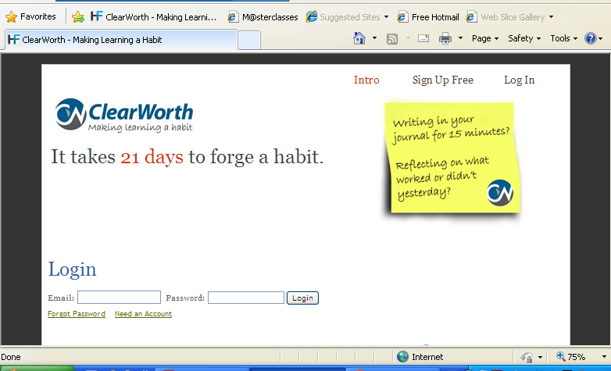
Notes:
Shift down so bottom right by log-in

Slide 5
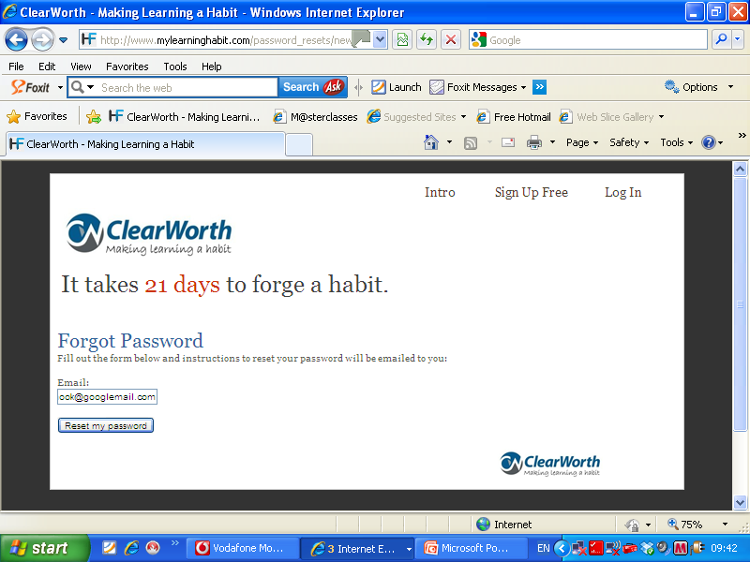
Notes:
add post-it with new caption supplied in word doc

Slide 6
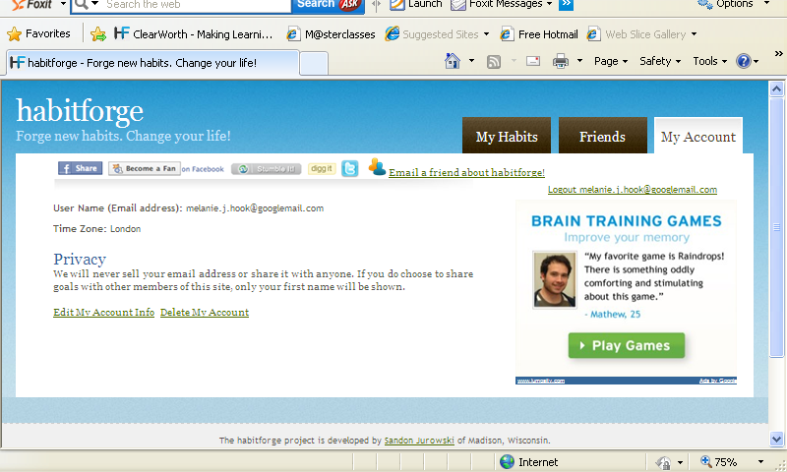
Notes:
Log-in to change password page from an email link needs CW colours/post-it.

Slide 7
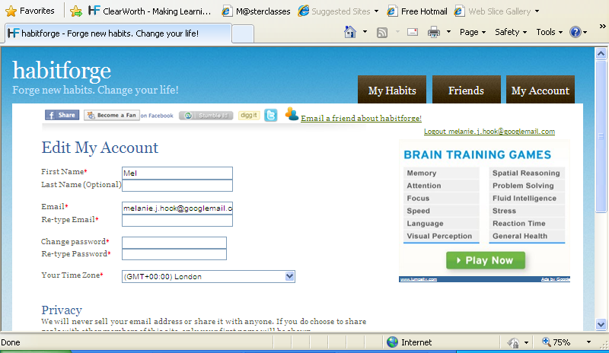
Notes:
Change to CW colours/ add post-it

Slide 8
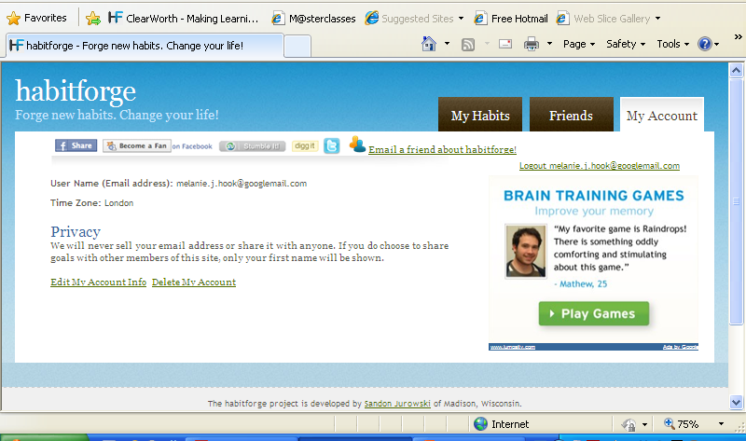
Notes:
Change to CW colours/ add post-it

Slide 9
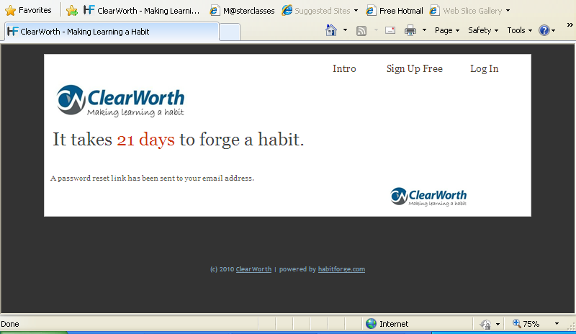
Notes:
Password reset confirmation page – add post-it to right

Slide 10
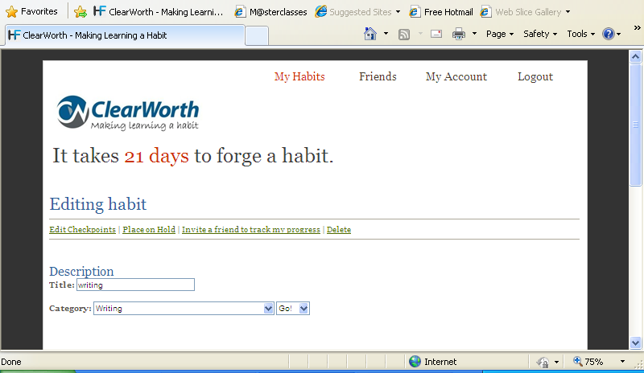
Notes:
Editing your habit page – add post-it to right

Slide 11
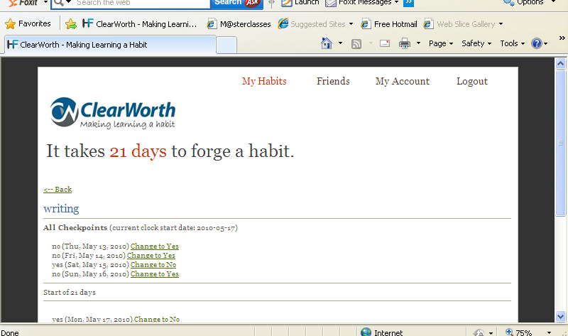
Notes:
add post-it to right

Slide 12
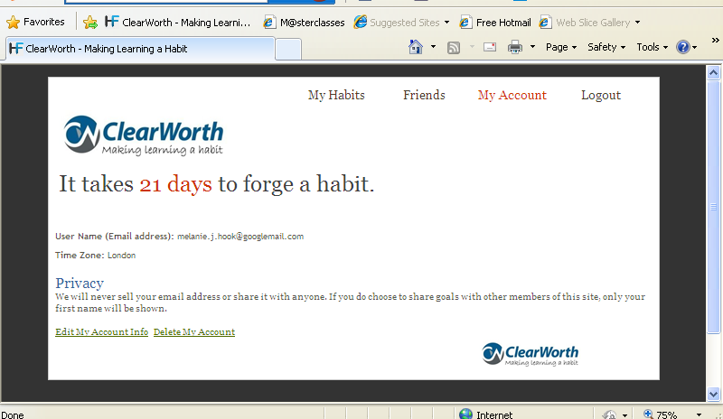
Notes:
My account page once logged in via forgotten password email link– add post-it image

